Slide 1

Algorithms and Data Structures 2 CS 1501
Spring 2022
Sherif Khattab
ksm73@pitt.edu
(Slides are adapted from Dr. Ramirez’s and Dr. Farnan’s CS1501 slides.)

Slide 2
Announcements
Upcoming deadlines:
Homework 12 due on 4/18
Assignment 3 and 4 due on 4/18
Lab 12 due on 4/22
Assignment 5 due on 5/2
Bonus Opportunities:
Bonus Lab due on 5/2
Bonus Homework due on 5/2
1 bonus point for entire class when response rate >= 80%
Currently at ~11%
Deadline is Sunday 4/24

Slide 3
Previous lecture …
(Big)Integer Algorithms
exponentiation
GCD
Random generation of large prime numbers
RSA Security

Slide 4
CourseMIRROR Reflections (most confusing)
Symmetric vs asymmetric encryption, what is the role of keys in both situations?
what is the purpose of euclids algorithm and extended euclids algorithm?
why gcd is exponential runtime but also linear runtime
I would like to go over more examples with GCD
Extended Euclids Algorithm was a bit fast and Im not sure I understand it
I was confused about the hashing example
I was confused about the example of using a hash function with RSA
I was confused how signing a message with RSA encryption worked
how rsa works was a little confusing
RSA keypairs
Lots of number theory very fast. Will take time to digest. Not connected to class: why will quantum computers make rsa no longer useful?
Recurrence relations were most confusing.
The master method. We kind of ran out of time on it. Would like to see more

Slide 5
CourseMIRROR Reflections (most interesting)
Different ways of encryption through algorithms/encryption in general
Simplicity of effective encryption techniques
How simple encoding can be sometimes
use of one time pads in encryption
Using algorithms from thousands of years ago to use stuff we use daily
I found the idea of Eulers totient to be an interesting idea, I wonder what other properties it has
Euclids method was interesting especially how it was faster than brute force
Euclids algorithm was very genius
the rsa encrypt and decrypt example
Learning about RSA envelopes and how they’re used everywhere
using an RSA envelope to cut down on runtime
The giant runtimes of some of the example algorithms we went over
I found the time to decrypt in years for some parts very interesting
The use of modular arithmetic to simplify exponentiation in RSA
I enjoy learning about crypto

Slide 6
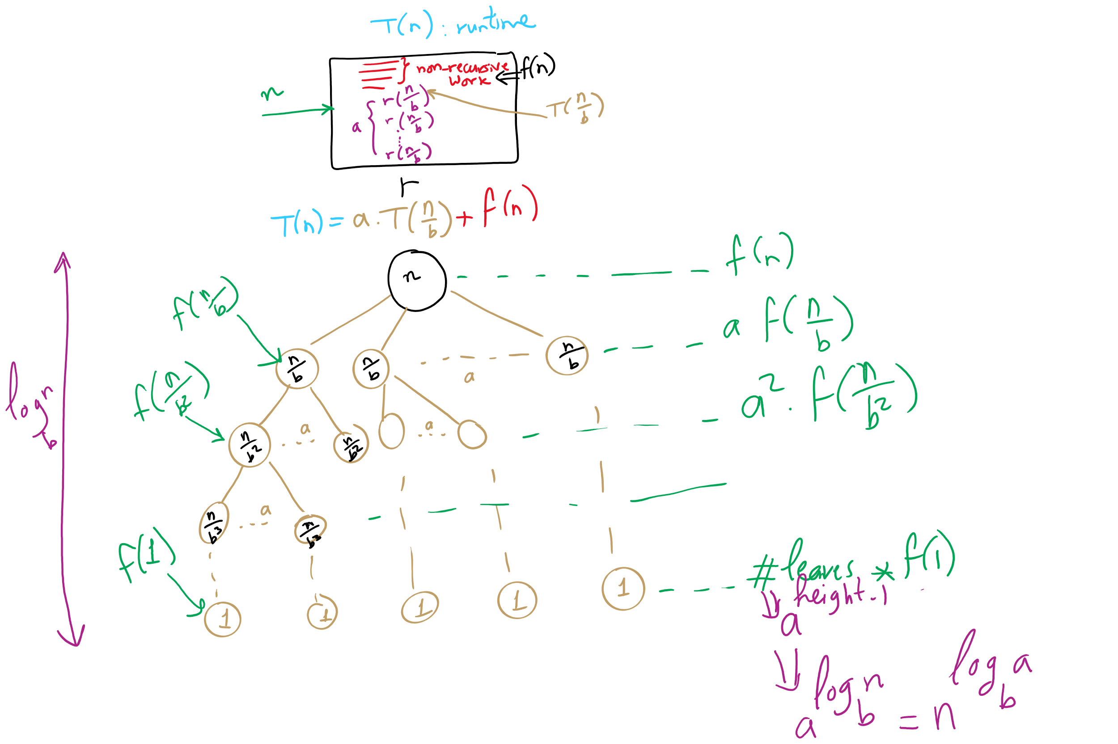
Run-time Analysis of Recursive Algorithms

Slide 7
Recursion Tree

Slide 8
Applying the master theorem
T(n) = aT(n/b) + f(n)
If f(n) is O(n^{log_b(a) - ε}):
T(n) is Θ(n^{log_b(a)})
If f(n) is Θ(n^{log_b(a)})
T(n) is Θ(n^{log_b(a)} lg n)
If f(n) is Ω(n^{log_b(a) + ε}) and (a * f(n/b) <= c * f(n)) for some c < 1:
T(n) is Θ(f(n))
Notes:
T(n) = 2T(n/2) + n lg n
falls into a gap
n lg n is asymptotically larger than n, but not polynomially larger

Slide 9
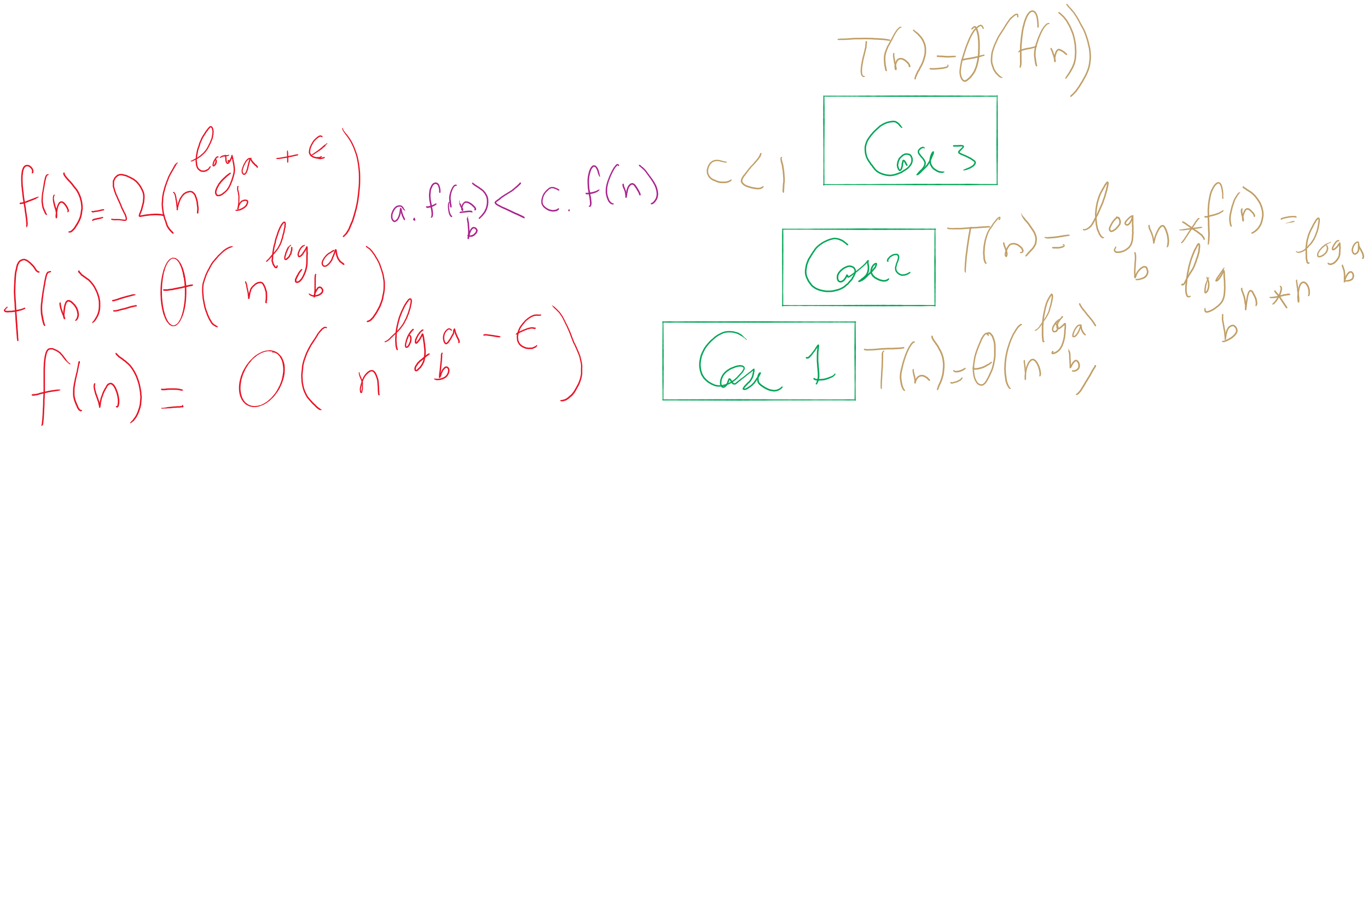

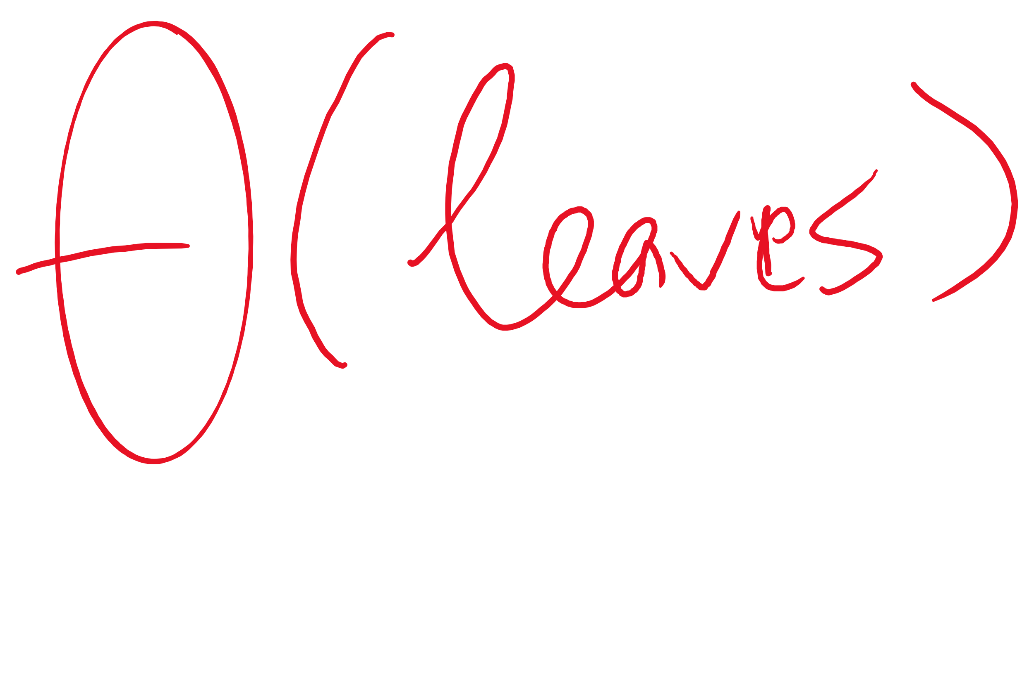
The 3 cases of the Master Theorem

Slide 10
Mergesort master theorem analysis
Recurrence relation for mergesort?
T(n) = 2T(n/2) + Θ(n)
T(n) = 2T(n/2) + Θ(n)
If f(n) is O(n^{log_b(a) - ε}):
T(n) is Θ(n^{log_b(a)})
If f(n) is Θ(n^{log_b(a)})
T(n) is Θ(n^{log_b(a)} lg n)
If f(n) is Ω(n^{log_b(a) + ε}) and (a * f(n/b) <= c * f(n)) for some c < 1:
T(n) is Θ(f(n))
a = 2
b = 2
f(n) is Θ(n)
So...
n^{log_b(a)} = …
n^{lg 2} = n
Being Θ(n) means f(n) is Θ(n^{log_b(a)})
T(n) = Θ(n^{log_b(a)} lg n) = Θ(n^{lg 2} lg n) = Θ(n lg n)

Slide 11
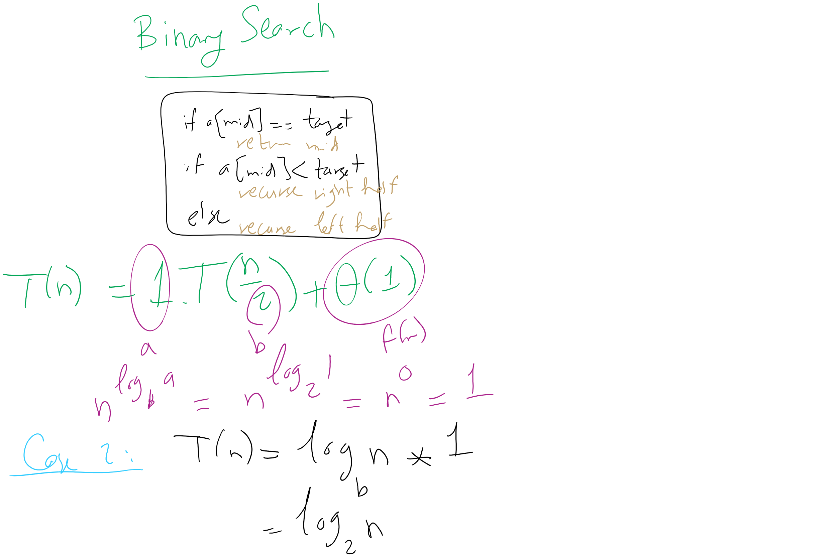
Binary Search Master Theorem Analysis

Slide 12
For our divide and conquer multiplication approach
T(n) = 4T(n/2) + Θ(n)
a = 4
b = 2
f(n) is Θ(n)
So...
n^{log_b(a)} = …
n^{lg 4} = n²
If f(n) is O(n^{log_b(a) - ε}):
T(n) is Θ(n^{log_b(a)})
If f(n) is Θ(n^{log_b(a)})
T(n) is Θ(n^{log_b(a)} lg n)
If f(n) is Ω(n^{log_b(a) + ε}) and (a * f(n/b) <= c * f(n)) for some c < 1:
T(n) is Θ(f(n))
Being Θ(n) means f(n) is polynomially smaller than n²
T(n) = Θ(n^{log_b(a)}) = Θ(n^{lg 4}) = Θ(n²)

Slide 13
Attacking a Recurrence Relation to Reduce Run-time
Look at the recurrence relation again to see where we can improve our runtime:
T(n) = 4T(n/2) + Θ(n)
Can we reduce the amount of work done by the current call?
Can we reduce the number of subproblems?
Can we reduce the subproblem size?

Slide 14
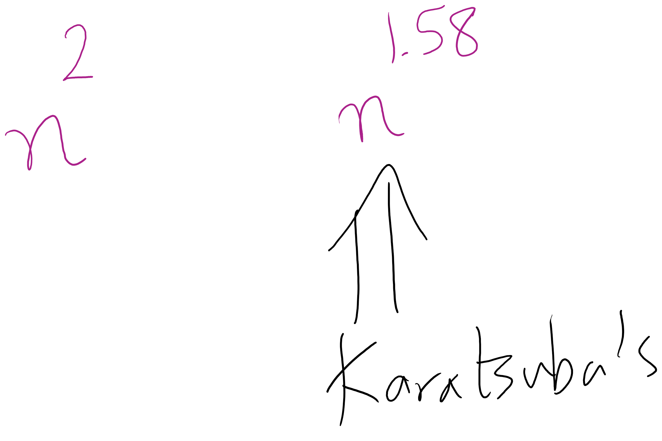
Karatsuba runtime
The recurrence relation for Karatsuba’s algorithm is:
T(n) = 3T(n/2) + Θ(n)
Which solves to be Θ(n^{lg 3})
Asymptotic improvement over grade school algorithm!
For large n, this will translate into practical improvement

Slide 15
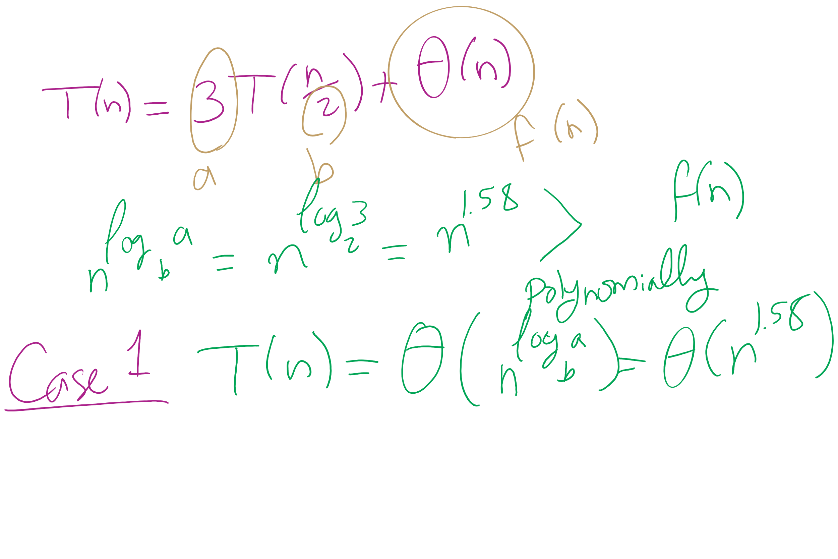
Karatsuba Runtime

Slide 16
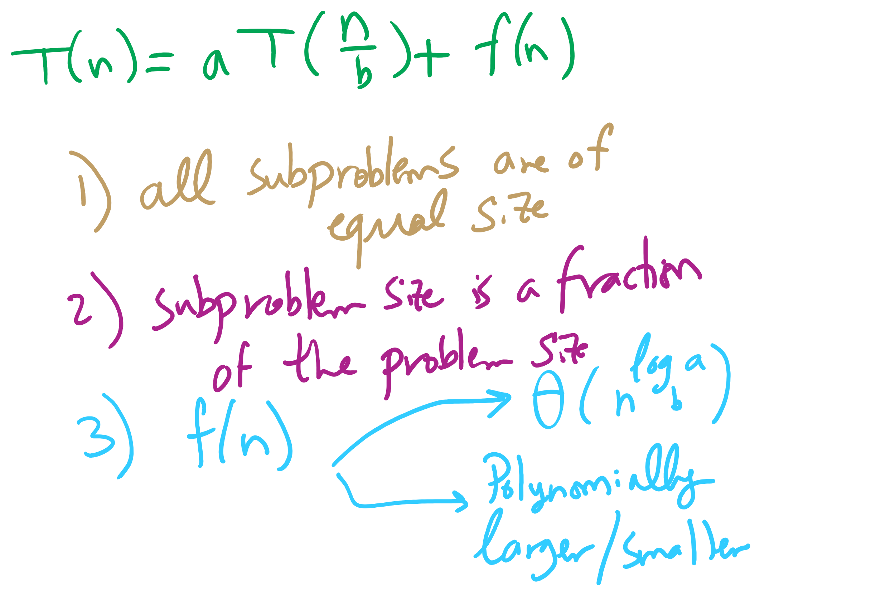
When can we use the Master Theorem?

Slide 17
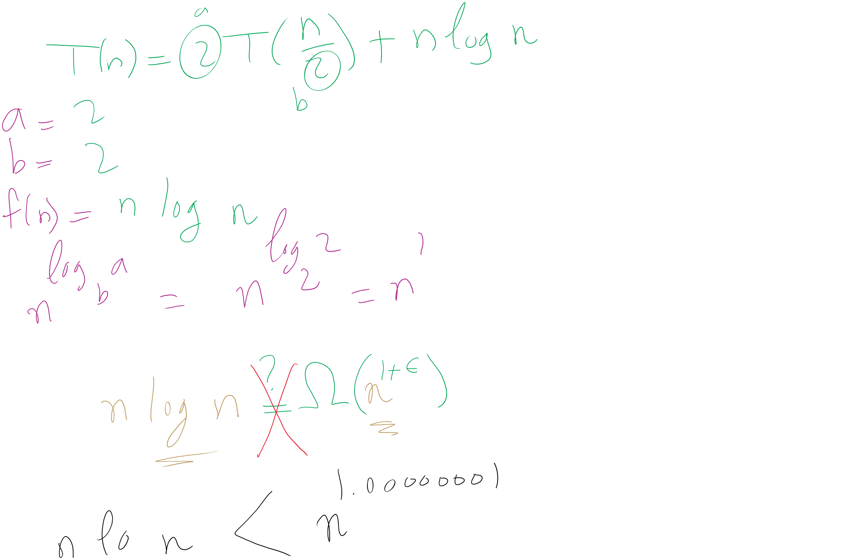
When Master Theorem doesn’t apply: Example 1

Slide 18
When Master Theorem doesn’t apply: Example 2
Top-down divide and conquer algorithm for exponentiation
x^{y} = (x^{(y/2)})² = x^{(y/2)} * x^{(y/2)}
Similarly, (x^{(y/2)})² * x = x^{(y/2)} * x^{(y/2)} * x
So, our recurrence relation is:
T(n) = T(n-1) + ?
How much work is done per call?
1 (or 2) multiplication(s)
Examined runtime of multiplication last lecture
But how big are the operands in this case?

Slide 19
Problem of the Day Part 3: The unbounded knapsack problem
Given a knapsack that can hold a weight limit L, and a set of n types items that each has a weight (w_{i}) and value (v_{i}), what is the maximum value we can fit in the knapsack if we assume we have unbounded copies of each item?
Notes:
Start off asking how to solve problem (greedy or dp?)
Does it exhibit optimal substructure?
Does it exhibit greedy choice property?
Does it exhibit overlapping subproblems?

Slide 20



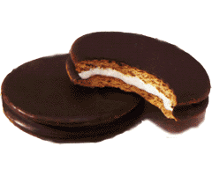

Recursive Solution
weight:
6
3
4
2
10 lb. capacity
value:
30
14
16
9
How much value in 10 lbs?
4 lbs?
8 lbs?
7 lbs?
6 lbs?
0?
2?
2?
6?
1?
5?
4?
1?
5?
0?
4?
4?
3?
3?
2?

Slide 21
Recursive Solution
weight:
6
3
4
2
10 lb. capacity
value:
30
14
16
9
How much value in 10 lbs?
4 lbs?
8 lbs?
7 lbs?
6 lbs?
0?
2?
2?
6?
1?
5?
4?
1?
5?
0?
4?
4?
3?
3?
2?

Slide 22
Bottom-up Solution
weight:
6
3
4
2
value:
30
14
16
9
Size:
0
1
2
3
4
5
6
7
8
9
10
Max val:
0
0
9
14
18
23
30
32
39
44
48
Notes:
Compute values to take max of on board

Slide 23
Bottom-up solution
K[0] = 0
for (l = 1; l <= L; l++) {
int max = 0;
for (i = 0; i < n; i++) {
if (w_{i} <= l && v_{i} + K[l - w_{i}]) > max) {
max = v_{i} + K[l - w_{i}];
}
}
K[l] = max;
}
Notes:
Runtime:
nL
though L’s input size is in bits, hence:
n * 2^{|L|}

Slide 24
What would have happened with a greedy approach?
At each step, the algorithm makes the choice that seems to be best at the moment
Have we seen greedy algorithms already this term?
Yes!
Building Huffman trees
Prim’s, Kruskal’s MST
Dijkstra’s Single-Source Shortest Paths

Slide 25
The greedy algorithm
Try adding as many copies of highest value per pound item as possible:
Water: 30/6 = 5
Rope: 14/3 = 4.66
Flashlight: 16/4 = 4
Moonpie: 9/2 = 4.5
Highest value per pound item? Water
Can fit 1 with 4 space left over
Next highest value per pound item? Rope
Can fit 1 with 1 space left over
No room for anything else
Total value in the 10 lb knapsack?
44
Bogus!

Slide 26
But why doesn’t the greedy algorithm work for this problem?
For greedy algorithms to produce optimal results, problems must have two properties:
Optimal substructure
Optimal solution to a subproblem leads to an optimal solution to the overall problem
The greedy choice property
Globally optimal solutions can be assembled from locally optimal choices
Why is optimal substructure not enough?
Notes:
Opt. substructure:
If we know the best way to make 3 cents, we can use that to find the best way to make 6 cents
Greedy choice:
When looking to make 6 cents, we know for US currency that the best overall choice will be to use the biggest coin (nickel)
With thrickels/fourters, we can't know until we've looked at all possible breakdowns
Note that this can be done recursively

Slide 27
The bottom-up approach is called dynamic programming!
Applies to problems with two properties:
Optimal substructure
Optimal solution to a subproblem leads to an optimal solution to the overall problem
Overlapping subproblems
Naively, we would need to recompute the same subproblem multiple times
Greedy Choice Property is not required
Notes:
Note that both problems amenable to DP and those amenable to greedy exhibit optimal substructure, the difference is if the greedy choice property exists or if overlapping subproblems

Slide 28
Problem of the Day Part 2: The 0/1 knapsack problem
What if we have a finite set of items that each has a weight and value?
Two choices for each item:
Goes in the knapsack
Is left out

Slide 29
0/1 Recursive solution
weight:
6
3
4
2
value:
30
14
16
9
How much value in 10 lbs?
10 lbs?
4lbs?
10 lbs?
7 lbs?
4 lbs?
1 lbs?
10 lbs?
7 lbs?
4 lbs?
1 lbs?
6 lbs?
3 lbs?
0 lbs?

Slide 30
Recursive solution
int knapSack(int[] wt, int[] val, int L, int n) {
if (n == 0 || L == 0) { return 0 };
if (wt[n-1] > L) {
return knapSack(wt, val, L, n-1)
}
else {
return max( val[n-1] + knapSack(wt, val, L-wt[n-1], n-1), knapSack(wt, val, L, n-1) ); }
}

Slide 31
The 0/1 knapsack dynamic programming solution
wt = [ 6, 3, 4, 2 ]
val = [ 30, 14, 16, 9 ]
K[n+1][L+1]
i\l | 0 | 1 | 2 | 3 | 4 | 5 | 6 | 7 | 8 | 9 | 10
0
1
2
3
4
K[i][l] is the best (max) value when only the first i items are available and only l lbs remain in the knapsack
Notes:
n: number of items (indexed by i)
L: weight limit (intermediary “limits” l)

Slide 32
The 0/1 knapsack dynamic programming solution
wt = [ 6, 3, 4, 2 ]
val = [ 30, 14, 16, 9 ]
i\l | 0 | 1 | 2 | 3 | 4 | 5 | 6 | 7 | 8 | 9 | 10
0 | 0 | 0 | 0 | 0 | 0 | 0 | 0 | 0 | 0 | 0 | 0
1 | 0
2 | 0
3 | 0
4 | 0
K[i][l] is the best (max) value when only the first i items are available and only l lbs remain in the knapsack
Notes:
n: number of items (indexed by i)
L: weight limit (intermediary “limits” l)

Slide 33
The 0/1 knapsack dynamic programming solution
wt = [ 6, 3, 4, 2 ]
val = [ 30, 14, 16, 9 ]
i\l | 0 | 1 | 2 | 3 | 4 | 5 | 6 | 7 | 8 | 9 | 10
0 | 0 | 0 | 0 | 0 | 0 | 0 | 0 | 0 | 0 | 0 | 0
1 | 0 | 0 | 0 | 0 | 0 | 0
2 | 0
3 | 0
4 | 0

Slide 34
The 0/1 knapsack dynamic programming solution
wt = [ 6, 3, 4, 2 ]
val = [ 30, 14, 16, 9 ]
i\l | 0 | 1 | 2 | 3 | 4 | 5 | 6 | 7 | 8 | 9 | 10
0 | 0 | 0 | 0 | 0 | 0 | 0 | 0 | 0 | 0 | 0 | 0
1 | 0 | 0 | 0 | 0 | 0 | 0 | 30 | 30 | 30 | 30 | 30
2 | 0
3 | 0
4 | 0

Slide 35
The 0/1 knapsack dynamic programming solution
wt = [ 6, 3, 4, 2 ]
val = [ 30, 14, 16, 9 ]
i\l | 0 | 1 | 2 | 3 | 4 | 5 | 6 | 7 | 8 | 9 | 10
0 | 0 | 0 | 0 | 0 | 0 | 0 | 0 | 0 | 0 | 0 | 0
1 | 0 | 0 | 0 | 0 | 0 | 0 | 30 | 30 | 30 | 30 | 30
2 | 0 | 0 | 0
3 | 0
4 | 0

Slide 36
The 0/1 knapsack dynamic programming solution
wt = [ 6, 3, 4, 2 ]
val = [ 30, 14, 16, 9 ]
i\l | 0 | 1 | 2 | 3 | 4 | 5 | 6 | 7 | 8 | 9 | 10
0 | 0 | 0 | 0 | 0 | 0 | 0 | 0 | 0 | 0 | 0 | 0
1 | 0 | 0 | 0 | 0 | 0 | 0 | 30 | 30 | 30 | 30 | 30
2 | 0 | 0 | 0 | 14 | 14 | 14 | 30 | 30 | 30 | 30 | 30
3 | 0
4 | 0

Slide 37
The 0/1 knapsack dynamic programming solution
wt = [ 6, 3, 4, 2 ]
val = [ 30, 14, 16, 9 ]
i\l | 0 | 1 | 2 | 3 | 4 | 5 | 6 | 7 | 8 | 9 | 10
0 | 0 | 0 | 0 | 0 | 0 | 0 | 0 | 0 | 0 | 0 | 0
1 | 0 | 0 | 0 | 0 | 0 | 0 | 30 | 30 | 30 | 30 | 30
2 | 0 | 0 | 0 | 14 | 14 | 14 | 30 | 30 | 30 | 30 | 30
3 | 0 | 0 | 0 | 0 | 16
4 | 0

Slide 38
The 0/1 knapsack dynamic programming solution
wt = [ 6, 3, 4, 2 ]
val = [ 30, 14, 16, 9 ]
i\l | 0 | 1 | 2 | 3 | 4 | 5 | 6 | 7 | 8 | 9 | 10
0 | 0 | 0 | 0 | 0 | 0 | 0 | 0 | 0 | 0 | 0 | 0
1 | 0 | 0 | 0 | 0 | 0 | 0 | 30 | 30 | 30 | 30 | 30
2 | 0 | 0 | 0 | 14 | 14 | 14 | 30 | 30 | 30 | 30 | 30
3 | 0 | 0 | 0 | 0 | 16 | 16 | 30 | 30 | 30 | 30 | 30
4 | 0

Slide 39
The 0/1 knapsack dynamic programming solution
wt = [ 6, 3, 4, 2 ]
val = [ 30, 14, 16, 9 ]
i\l | 0 | 1 | 2 | 3 | 4 | 5 | 6 | 7 | 8 | 9 | 10
0 | 0 | 0 | 0 | 0 | 0 | 0 | 0 | 0 | 0 | 0 | 0
1 | 0 | 0 | 0 | 0 | 0 | 0 | 30 | 30 | 30 | 30 | 30
2 | 0 | 0 | 0 | 14 | 14 | 14 | 30 | 30 | 30 | 30 | 30
3 | 0 | 0 | 0 | 0 | 16 | 16 | 30 | 30 | 30 | 30 | 30
4 | 0 | 0

Slide 40
The 0/1 knapsack dynamic programming solution
wt = [ 6, 3, 4, 2 ]
val = [ 30, 14, 16, 9 ]
i\l | 0 | 1 | 2 | 3 | 4 | 5 | 6 | 7 | 8 | 9 | 10
0 | 0 | 0 | 0 | 0 | 0 | 0 | 0 | 0 | 0 | 0 | 0
1 | 0 | 0 | 0 | 0 | 0 | 0 | 30 | 30 | 30 | 30 | 30
2 | 0 | 0 | 0 | 14 | 14 | 14 | 30 | 30 | 30 | 30 | 30
3 | 0 | 0 | 0 | 14 | 16 | 16 | 30 | 30 | 30 | 30 | 30
4 | 0 | 0 | 9 | 9 | 16 | 16 | 30 | 30 | 39 | 39 | 39

Slide 41
The 0/1 knapsack dynamic programming solution
int knapSack(int wt[], int val[], int L, int n) {
int[][] K = new int[n+1][L+1];
for (int i = 0; i <= n; i++) {
for (int l = 0; l <= L; l++) {
if (i==0 || l==0){ K[i][l] = 0 };
else if (wt[i-1] > l){ K[i][l] = K[i-1][l] };
else {
K[i][l] = max(val[i-1] + K[i-1][l-wt[i-1]], K[i-1][l]);
}
}
}
return K[n][L];
}
Notes:
n: number of items (indexed by i)
L: weight limit (intermediary “limits” l)

Slide 42
To review...
Questions to ask in finding dynamic programming solutions:
Does the problem have optimal substructure?
Can solve the problem by splitting it into smaller problems?
Can you identify subproblems that build up to a solution?
Does the problem have overlapping subproblems?
Where would you find yourself recomputing values?
How can you save and reuse these values?

Slide 43
Another Problem: Subset sum
Given a set of non-negative integers S and a value k, is there a subset of S that sums to exactly k?

Slide 44
Subset sum calls
SSS({1,2,3}, 6)
SSS({1,2}, 6)
SSS({1,2}, 3)
SSS({1}, 6)
SSS({1}, 4)
SSS({1}, 3)
SSS({1}, 1)
SSS({}, 6)
SSS({}, 4)
SSS({}, 3)
SSS({}, 1)
SSS({}, 5)
SSS({}, 3)
SSS({}, 2)
SSS({}, 0)

Slide 45
Subset sum recursive solution
boolean SSS(int set[], int sum, int n) {
if (sum == 0) return true;
if (sum != 0 && n == 0) return false;
if (set[n-1] > sum) return SSS(set, sum, n-1);
return SSS(set, sum, n-1) || SSS(set, sum-set[n-1], n-1); }
What would a dynamic programming table look like?

Slide 46
Subset sum bottom-up dynamic programming
boolean SSS(int set[], int sum, int n) { boolean[][] subset = new boolean[sum+1][n+1];
for (int i = 0; i <= n; i++) subset[0][i] = true; for (int i = 1; i <= sum; i++) subset[i][0] = false;
for (int i = 1; i <= sum; i++) { for (int j = 1; j <= n; j++) { subset[i][j] = subset[i][j-1]; if (i >= set[j-1]) subset[i][j] ||= subset[i - set[j-1]][j-1]; } }
return subset[sum][n];
}

